Slide 1
GDPR
25th MAY 2018

Slide 2
WHAT IS GDPR
GDPR (General Data Protection Regulations) came in on the 25th May 2018 and is a big overhaul on the current data protection laws that we have.
It enables people to have a much clearer understanding of what data of theirs is being used and what it is being used for. The GDPR sets out the rights that people have, and what you can and can’t do with processing.

Slide 3


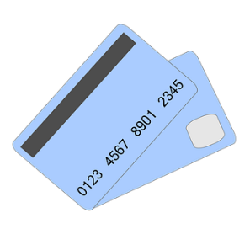


GDPR KEYWORDS
DATA SUBJECTS
SENSITIVE PERSONAL DATA
genetic
Sexual orientation
ethnicity
Health
Biometric
Political views
religion
INTERNAL STAFF/OUR WORKERS
PERSONAL DATA
Driving Licence
DOB
ONLINE IDENTIFIERS
Bank Details
Location Information

Slide 4


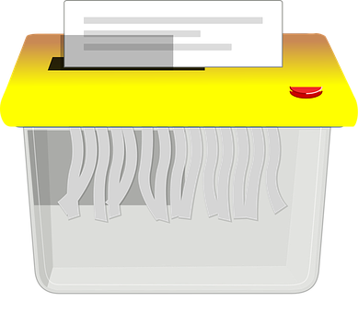



GDPR KEYWORDS
PROCESSING
COLLECTING
RECORDING/STORING/USING
ERASING
DESTROYING
DATA CONTROLLER
DATA PROCESSOR
DPO
The data controller is the person (or business) who determines the purposes for which, and the way in which, personal data is processed.
a data processor is anyone who processes personal data on behalf of the data controller (excluding the data controller’s own employees).
Data Protection Officer

Slide 5
DATA SUBJECT RIGHTS
TO BE INFORMED
TO ACCESS
To know what data we will be processing
Why we are processing it
How long we will keep it
They can send in a Subject Access Request
We have to give them their information within 30 days
Their info will include things like interview notes
THE DATA SUBJECT NEEDS TO BE INFORMED AT THE POINT WHEN
COLLECTING THE INFORMATION I.E. SO WHEN YOU ARE REGISTERING THEM WHETHER THAT IS OVER THE TELEPHONE OR WHEN COMPLETING AN APPLICATION FORM
TO DATA PORTABILITY
They have the right to move their data from one controller to another or to another data subject.
They can request we send their data for them. This is only for data that has been provided directly to us by the Data Subject
TO ERASURE
This means we need to remove all data we hold on the data subject
There are a few instances where certain data needs to be kept i.e. PAYE and NIC info

Slide 6
DATA SUBJECT RIGHTS
TO OBJECT
TO RESTRICT PROCESSING
This applies when the reason to process data is legitimate or in public interest
The effect is to stop the data being processed unless we can demonstrate legitimate grounds that outweigh the interest, rights and freedom of the date subject
They can ask to stop us processing their data but keep their data on file i.e. if they have a got a new job
If they think their data is incorrect they can restrict processing
TO CORRECTION
They can let us know changes to their data
We need to inform any 3rd parties we have given their data to of the correction
RIGHTS RELATING TO AUTOMATION
They have the right not to be the subject of automated decision making (including profiling) and this is very important when it comes to e-recruiting

Slide 7












SOURCES OF DATA
APPLICATION
FORMS
WEBSITE
OTHER SOURCES OF DATA – REMEMBER TO SEND THE PRIVACY NOTICE WITHIN 30 DAYS!
CV’s
JOB BOARDS
SOCIAL MEDIA
TELEPHONE
REFERRALS

Slide 8
CONSENT
Needs to be explicit clear and unambiguous
Needs to be completely separate i.e. not a tick box on an application form
Needs to be freely given i.e. “we can’t give you work unless you consent to this” is STRICTLY PROHIBITED
Needs to be as easy to withdraw as it is to give and it can be changed at anytime.
Needs to be recorded and there will be a folder on Adapt where all consent forms will be stored
Need to specify third parties to whom you are disclosing data to.

Slide 9




PROCESSING DATA WHEN CONSENT IS NOT RELIED UPON
Legal obligation for processing can include conduct regulations, checking right to work and processing tax/payroll records
The second reason for processing is for the performance of a contract. When a temporary worker signs our terms of engagement this is us entering in to a contract with them and if they do not want us to process their data we cannot give them any work.

Slide 10


SUBJECT ACCESS REQUESTS (SARS)
Individuals (e.g. employees) have a right to be informed by an organisation (e.g. their employer) whether or not it is processing personal data that relates to them and, if so, to be told:
What personal data it is being processed.
The purposes for which the personal data is being processed.
Who, if anyone, the personal data is disclosed to.
The extent to which it is using the personal data for the purpose of making automated decisions relating to the data subject and, if so, what logic is being used for that purpose.
We have
days to have requested information ready
IT IS VITAL THAT YOU EMAIL ANY SARS THROUGH TO DATA@COYLES.CO.UK AS SOON AS YOU RECEIVE THEM
There is no charge for a SAR

Slide 11
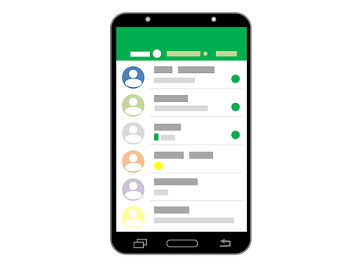
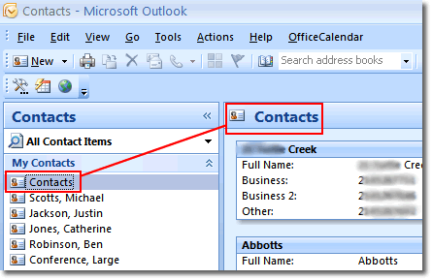
REMOVAL (REQUESTING DELETION)
If someone requests to be deleted, it means exactly that – delete them. This means from everything
Mobile Phone/Texts/WhatsApp
Spreadsheets
Outlook Contacts
IT IS VITAL THAT YOU EMAIL ANY REMOVAL REQUESTS THROUGH TO DATA@COYLES.CO.UK AS SOON AS YOU RECEIVE THEM SO THE DATA TEAM CAN DO A FULL REMOVAL ACROSS ALL SYSTEMS I.E. PAYROLL, ADAPT AND TO NOTIFY ANY THIRD PARTIES WHERE THEIR DATA MAY HAVE BEEN SHARED
As with the Subject Access Requests, failure to do this leaves us in breach of the regulations and disciplinary action will be taken as a result of this.

Slide 12

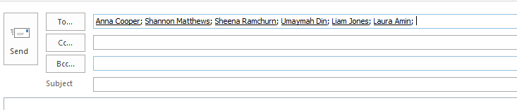
DON’T
SEND GROUP TEXT OR WHATSPP MESSAGES
In doing so you are sharing your candidates numbers with other people that you have not had permission to do so.
SEND GROUP EMAILS WITH ALL RECIPIENTS IN THE ‘TO’ BOX
If you have consent to send emails and are sending a group email – all recipients must be in the BCC box

Slide 13

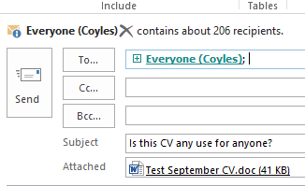
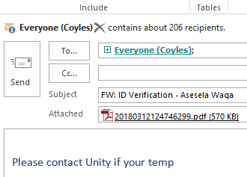
DON’T
SEND CVS OR ANYONES DATA AROUND THE COMPANY BY EMAIL
If you receive a CV that is not of use to you –please email it to the HR Department ONLY and then delete it from your inbox.
SEND EMAILS FROM THIRD PARTIES CONTAINING PERSONAL INFO I.E. PASSPORTS
Please check on the ADAPT system who registered the candidate and contact them directly DO NOT EMAIL EVERYONE IN THE COMPANY

Slide 14



DON’T
PROCESS ANYONE’S DATA WITHOUT SENDING THEM THE PRIVACY NOTICE
This needs to be sent to a temporary worker ASAP and before they are registered and put out to work.
PRIVACY
NOTICE
COERCE SOMEONE IN ANY WAY TO CONSENT TO PROCESSING
Consent needs to be freely given by a data subject and cannot be coerced in any way by you.

Slide 15

We know you like to use whiteboards in the offices…… you CANNOT write any personal information on the white boards as this is NOT SECURE…….
Would YOU want your private personal data written up for anyone to see…..
THINK BEFORE YOU INK

Slide 16

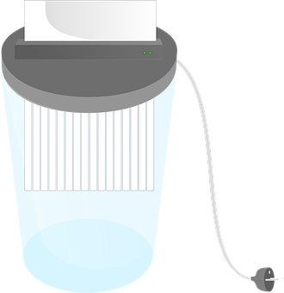




HARD COPY DOCUMENTS
KEEP THEM LOCKED AWAY
SHRED THEM WHEN FINISHED
DON’T LEAVE THEM LYING AROUND

Slide 17
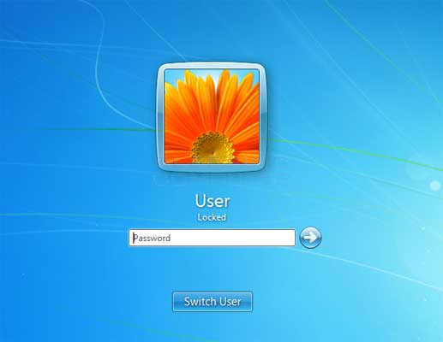


DO
LOCK YOUR MACHINES WHEN YOU ARE AWAY FROM YOUR DESK
  When you are away from your desk, please lock your machine so that no one can access it.
  You can do this by pressing the Windows key and the “L” key together.
EMAIL DATA@COYLES.CO.UK IF YOU ARE UNSURE ABOUT ANYTHING
The Team are here to help you and we would rather you contact us than get something wrong!
data@coyles.co.uk

Slide 18


DO
KEEP YOUR PASSWORDS SECURE
If you think anyone has got access to your password, please contact us immediately to get it changed
INFORM YOUR TEMPS HOW TO WITHDRAW CONSENT
Consent needs to be as easy to withdraw as it is to give, and data subjects need to be told how to withdraw it.

Slide 19
PRIVACY NOTICE
OUR PRIVACY NOTICE NEEDS TO…
be given to all employees and our workers
be given at the point when collecting the data i.e. when someone is registering for work
be emailed to someone if they send in a CV asking to keep on file for prospective work – this must be sent ASAP
OUR PRIVACY NOTICE WILL OUTLINE…
what data we will collect and why
the rights of the data subject
how to complain
the purpose of processing
our legitimate business interest
what data is collected when someone visits our website

Slide 20

DIRECT MARKETING
You can still cold-call clients and candidates when there is a legitimate business interest to do so i.e. to see if they have any supply requirements or to see if they are looking for work.
WHEN COLD CALLING IT IS VERY IMPORTANT TO MAKE SURE YOU DO STOP CALLING IF SOMEONE ASKS YOU TO AS YOU DO NOT HAVE THEIR CONSENT TO CALL THEM.

Slide 21

DISCIPLINARY/FINES
Just for your information the fines for a data breach under GDPR are:
  Tier 1 - €10million or 2% of annual turnover
  Tier 2 - €20million or 4% of annual turnover
IT IS VITAL THAT YOU ALL FOLLOW PROCEDURES. GDPR BREACHES ARE TO BE WRITTEN INTO OUR DISCIPLINARY PROCEDURES AND FAILURE TO FOLLOW THESE RULES IS MISCONDUCT AND NECESSARY DISCIPLINARY ACTION WILL BE TAKEN DEPENDANT ON THE LEVEL OF THE BREACH

Slide 22


USEFUL CONTACTS
Our DPO: Chris Coyle
Any queries: data@coyles.co.uk
If you think your own data is breached/if you want to action one of your rights: data@coyles.co.uk
If you want to make a complaint against the company you need to contact the ICO: 03031231113
If you have any general questions please contact Human Resources and we will do our best to assist you.

Slide 23


WHAT WE ARE GOING TO DO
Improve our processes to include online candidate application forms
Send further training guidelines
Implement online consent forms for your candidates
Keep you informed
Make improvements to Adapt to record workers consent options
Answer any questions you have

Slide 24
ADAPT V2.8
There is a whole GDPR functionality upgrade coming in Adapt version 2.8. This will enable us to manage our GDPR requirements much more easily, particularly managing consent.
What you need to do
You will need to stop writing comments in to Adapt about your workers. A temporary worker will have visibility to their Adapt record and everything in it.
What we will do
We will be training you fully on the new Adapt system when it comes in and will be showing you how to manage GDPR requirements through the Adapt system.
IF SOMEONE SENDS IN A SAR AND YOU EDIT THE DATA AFTER THE REQUEST THEY WLL BE ABLE TO SEE THAT THEIR DATA HAS BEEN EDITED

